Slide 1
Private Credit Monitor
October 2025

Slide 2
Direct lending deal volume stabilizes – Greater visibility into trade policy and rate trajectories is helping restore new issue volumes to a more typical pace. Direct lending activity saw a modest uptick as the fourth quarter got underway. LCD tracked $63 billion across 211 deals in the three months to Oct. 31, an improvement over 3Q25 levels ($60 billion / 201 deals). Although the year-to-date pace trails 2024 by about 15% in terms of both volume and count, market sentiment is improving—with BDCs reporting a noticeable acceleration in the volume of transactions under review in comments on 3Q25 earnings calls.
M&A outlook – Earnings calls from BDCs reporting third-quarter results indicate that M&A activity continues to strengthen, adding to improved market sentiment that began late in the second quarter. More stable financial markets and renewed sponsor confidence have supported higher transaction volumes, while corporate management teams are increasingly refocusing on long-term strategic growth initiatives. For instance, Ares reported a record $3 billion backlog as of October 23, 2025, with approximately half of third-quarter originations tied to M&A-related deals and about 60% coming from new borrowers, signaling less reliance on deal activity originating from existing portfolio companies that is common when M&A activity is low. While some management teams remain cautious and do not foresee a broad-based M&A recovery in the near term, overall momentum is improving. With interest rates easing and confidence building, 2026 is shaping up to be a potentially active period for M&A and financing activity.
Repayments – Lenders report that repayment activity remains strong, supported by a more active market environment. LCD data shows that roughly 30% of new issue deals to PE-backed borrowers done in the last three months supported either a refinancing or a recapitalization, slightly higher than the 25% share for January through September period. With spreads compressing across both liquid and private credit markets so far this year, borrowers are seizing the opportunity to lower their cost of debt. For example, Sixth Street BDC reported that 75% of repayments were driven by refinancings at lower spreads in the private credit or broadly syndicated loan markets.
Give-and-take – LCD recorded $5.8 billion in direct lending loans refinanced into the broadly syndicated market during the three months ended October 31, down from $10.2 billion in the prior quarter, which was elevated by the large Finastra transaction. Year to date, approximately $29 billion has shifted from direct lenders to the syndicated market—roughly offset by a similar volume moving in the opposite direction. In October, for instance, Ping Identity issued a $1.8 billion term loan B to refinance private debt and fund a dividend; at the end of June, the company was held by at least a dozen BDCs. The existing private loan due October 2029 priced at S+475 with a 0.75% floor, while the new TLB priced tighter at S+275 with no floor. Conversely, Shutterfly raised $2 billion in private credit financing to refinance portions of its public debt, underscoring the ongoing two-way flow between the private and syndicated loan markets.
Credit spreads remain compressed but steady – Direct lending spreads have remained relatively stable in recent months, although pricing dispersion has narrowed, with most unitranche loans clustering in the SOFR +450–500 bps range. Looking at direct lending deals financing buyouts, 45% of deals tracked by LCD fell in that range, down from just 18% in 2024 and less than 5% in 2023 and 2022.
Notes:
Updated 11/6/2025

Slide 3
Direct Lending Volume & Counts

Slide 4
Direct lending activity shows a modest uptick as the fourth quarter begins.
Direct lending deal count and estimated volume (quarterly) ($B)
Source: PitchBook | LCD • Geography: US • *As of Oct. 31, 2025
Deal count is based on transactions covered by LCD News
Notes:
Updated 11/4/25

Slide 5
2025 issuance is running 15% behind the 2024 pace
Direct lending deal count and estimated volume (annual) ($B)
Source: PitchBook | LCD • Geography: US • *As of Oct. 31, 2025
Deal count is based on transactions covered by LCD News
Notes:
Updated 11/4/25

Slide 6
PE-backed direct lending deal count held steady as volume inched up
Direct lending deal count and estimated volume, sponsor-backed borrowers (quarterly) ($B)
Source: PitchBook | LCD • Geography: US • *As of Oct. 31, 2025
Deal count is based on transactions covered by LCD News
Notes:
Updated 11/4/25

Slide 7
Deal count trails 2024 by 25% thanks to slower 2Q and 3Q
Direct lending deal count and estimated volume, sponsor-backed borrowers (annual) ($B)
Source: PitchBook | LCD • Geography: US • *As of Oct. 31, 2025
Deal count is based on transactions covered by LCD News
Notes:
Updated 11/4/25

Slide 8
Refinancings and recapitalizations remained an active part of the market
Count of PE-backed direct lending deals by use of proceeds
Source: PitchBook | LCD • Geography: US • *As of Oct. 31, 2025
Deal count is based on transactions covered by LCD News
Notes:
Updated 11/4/25

Slide 9
LBO count fell to the lowest level in two years
Direct lending deal count and estimated volume of deals financing buyouts (quarterly) ($B)
Source: PitchBook | LCD • Geography: US • *As of Oct. 31, 2025
Deal count is based on transactions covered by LCD News
Notes:
Updated 11/3/25

Slide 10
2025 LBO volume slightly ahead of last year but deal count lags
Direct lending count and estimated volume of deals financing LBOs (annual) ($B)
Source: PitchBook | LCD • Geography: US • *As of Oct. 31, 2025
Deal count is based on transactions covered by LCD News
Notes:
Updated 11/3/25

Slide 11
Healthcare and Technology sectors expanded their share of deal activity, while Services saw a pullback vs 2024
New-issue direct lending top 10 sectors – share by deal count
Source: PitchBook | LCD • Geography: US • *As of Oct. 31, 2025
Notes:
Updated 11/4/25

Slide 12
Spreads

Slide 13
M&A activity remains light; spreads tighten amid competition for paper
New-issue spread of acquisition-related deals, PE-backed borrowers
Source: PitchBook | LCD • Geography: US • *As of Oct. 31, 2025
Direct lending data is based on transactions covered by LCD News, BDC filings and other public sources
Notes:
Updated DL 11/5/2025 and BSL 11/4/25, BSL based on B- on one side as opposed to B- BLR

Slide 14
Spreads compress amid competition for quality deals, with half the market below 500 bps so far in 2025
New-issue spread distribution of LBOs financed in direct lending market
Source: PitchBook | LCD • Geography: US • *As of Oct. 31, 2025
Data reflects senior secured loans and unitranche facilities.
Notes:
Updated 11/4/25

Slide 15
The difference in BSL and direct lending spreads has compressed amid competition for larger deals
Spread of LBOs financed in BSL (B-minus borrowers) vs direct lending market
Source: PitchBook | LCD • Geography: US • *As of Oct. 31, 2025
Direct lending spread data reflects senior secured first-lien loans and unitranche facilities. BSL data reflects loans issued to borrowers rated B-minus.
Notes:
DL and BSL Updated 11/4/25, BSL based on B- on one side as opposed to B- BLR

Slide 16
LBO cost of debt contracts across both private and liquid credit markets
Spread of LBOs financed in BSL (all borrowers) vs direct lending market
Direct lending spread data reflects senior secured first-lien loans and unitranche facilities. BSL data reflects loans issued to all leveraged borrowers.
Source: PitchBook | LCD • Geography: US • *As of Oct. 31, 2025
Notes:
DL and BSL Updated 11/4/25

Slide 17
Broadly Syndicated vs. Direct Lending Market

Slide 18
While BSL-financed LBO counts have been stable, direct lending has experienced a slowdown
Count of LBO deals financed in BSL vs direct lending market (quarterly)
Source: PitchBook | LCD • Geography: US • *As of Oct. 31, 2025
Deal count is based on transactions covered by LCD News
Notes:
Updated 11/3/25

Slide 19
As BSL and direct lending volumes converge
New-issue volume for LBOs financed in BSL vs direct lending market (quarterly) ($B)
Source: PitchBook | LCD • Geography: US • *As of Oct. 31, 2025
Notes:
Updated 11/3/25

Slide 20
Weakness in the secondary syndicated loan market during October curtailed opportunistic activity
Count of sponsor-backed deals financed in BSL vs direct lending market (quarterly)
Source: PitchBook | LCD • Geography: US • *As of Oct. 31, 2025
Deal count is based on transactions covered by LCD News
Notes:
Updated 11/4/25

Slide 21
Compressing overall BSL volume in the last three months
New-issue sponsor-backed volume for loans financed in BSL vs private credit market (quarterly) ($B)
Source: PitchBook | LCD • Geography: US • *As of Oct. 31, 2025
Notes:
Updated 11/4/25

Slide 22
Business Development Companies (BDCs)

Slide 23
BDC portfolios signal further spread compression
BDC holdings spread distribution ranges (bps) by share of portfolio, based on count
Source: PitchBook | LCD • Geography: US • *As of June 30, 2025
Notes:
Updated 11/3/25 used Armando’s version

Slide 24
Nearly 30% of unitranche facilities held by BDCs had spreads under S+500 as of June 30, 2025, up from 17% at the end of 2024
Spread range (bps) for unitranche loans held by BDCs, based on count
Source: PitchBook | LCD • Geography: US • *As of June 30, 2025
Notes:
Updated 11/3/25 used Armando’s version

Slide 25
While first-lien spreads were evenly balanced between sub-500 bps and 600+ bps at the end of 2024, by June 2025, tighter-priced loans had become far more prevalent within BDC holdings
Spread range (bps) for senior secured first-lien term loans held by BDCs
Source: PitchBook | LCD • Geography: US • *As of June 30, 2025
Notes:
Updated 11/3/25 used Armando’s version

Slide 26
Commercial Services and Software lead among BDC holdings by sector
Count of BDC holdings by sector (%)
Source: PitchBook | LCD • Geography: US • *As of June 30, 2025
Notes:
Updated 11/3/25 using Platform version

Slide 27
Direct Lending AUM, Private Debt Capital Raised, & CLO Issuance

Slide 28
Direct lending AUM rises steadily
US direct lending AUM ($B)
Source: PitchBook • Geography: US • *As of Mar. 31, 2025
Notes:
Updated 11/3/25

Slide 29
Private debt fundraising is slightly off last year’s pace
US private debt capital raised by type ($B)
Source: PitchBook • Geography: US • *As of Sep. 30, 2025
Notes:
Updated 11/3/25

Slide 30
Issuance of middle market and private credit CLOs remains robust
US middle market/private credit CLO issuance ($B)
Source: PitchBook | LCD • Geography: US • *As of Oct. 31, 2025
Notes:
Updated 11/3/25

Slide 31
BSL & Direct Lending Takeouts

Slide 32
In a competitive tug-of-war for deals, direct lenders captured roughly $29B from the BSL market this year—offset by an equivalent flow in the opposite direction
Syndicated loans and direct lending takeouts ($B)
Source: PitchBook | LCD • Geography: US • *As of Oct. 31, 2025
Historical data is subject to revisions as LCD collects additional information.
Notes:
Updated 11/7/25

Slide 33
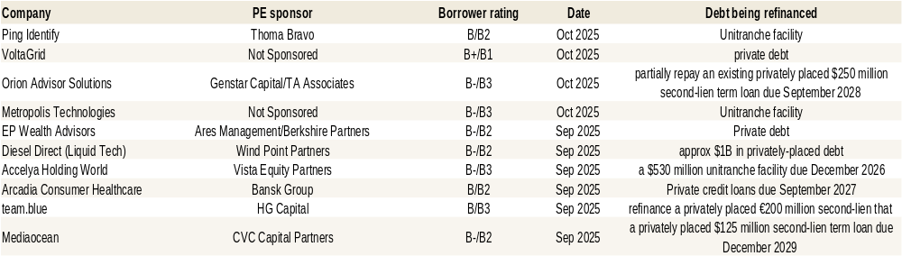
Borrowers refinancing their direct lending deals in the broadly syndicated markets find attractive pricing…
Last ten syndicated term loans that refinance debt provided by direct lenders
Source: Pitchbook | LCD • Geography: US • *As of Oct. 31, 2025
Table is based on LCD News reporting.
Notes:
Updated 11/5/25

Slide 34
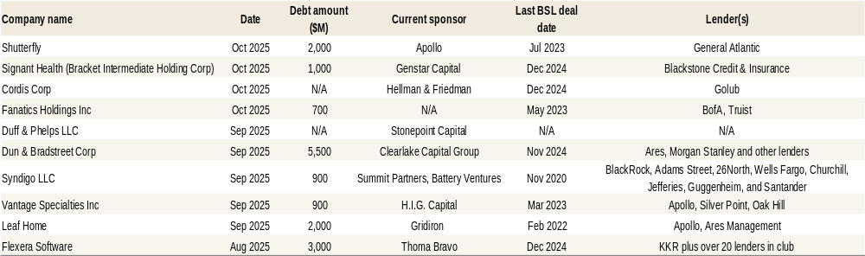
…while those leaving the BSL space find flexibility, certainty of execution and other benefits, competitive pricing
Most recent direct lending deals refinancing broadly syndicated term loans
Source: PitchBook | LCD • Geography: US • *As of Oct. 31, 2025
Table is based on LCD News reporting.
Notes:
Updated 11/6/25

Slide 35
Methodology

Slide 36
Data composition:
Unless otherwise noted, data reflects new-issue direct lending transactions as tracked by PitchBook LCD. Except for BDC analysis, charts reflect new transactions in the US direct lending market, including both private-equity-backed borrowers and non-backed borrowers, as covered by LCD News.
We define direct lending as directly originated loans to corporate borrowers that are not broadly syndicated. These borrowers are typically unrated and tend to be small to midsized companies. However, in recent years, larger borrowers have also issued this type of financing. This type of financing is typically provided by a non-bank lender, or a small “club,” or group, of lenders. These loans are generally not tradeable as broadly syndicated loans are. Lenders usually provide the financing with the intention of holding the debt to maturity.
BDC analysis is based on quarterly filings of over 100 BDC portfolios as tracked by PitchBook LCD.
Given the opaque nature of the direct lending market, deal size is not available for every transaction. To calculate overall volume, LCD estimates deal size where it is not available using historical averages within our dataset.
Contacts:
Research
Marina Lukatsky, Global Head of Research, Credit & Private Equity Marina.Lukatsky@pitchbook.com
Data
Jack Johnson, Data Analyst, jack.johnson@pitchbook.com
Support
PB Support, support@pitchbook.com

